Slide 1



SEKILAS INFO TENTANG
SDGS DESIGN LAB - POLTEKSI
TM - TI - AK - AP
POLITEKNIK SEMEN INDONESIA
By : Nugrahadi Djazaul Mukhsinin
1

Slide 2
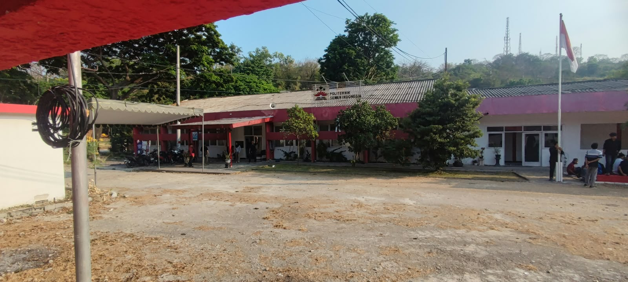
BANGUNAN KAMPUS POLTEKSI
sebutkan dengan keras, tulisan ini berwarna apa
merah
hijau
Tempat berkumpulnya para praktisi proyek Tuban 1 & 2
Tempat memproduk karya keteknikan pembangunan Pabrik Semen kapasitas terbesar
Engineering (Sipil, Mekanikal, Elektrikal, Instrumen, Adminsitrasi, Keuangan, SDM dll)

Slide 3
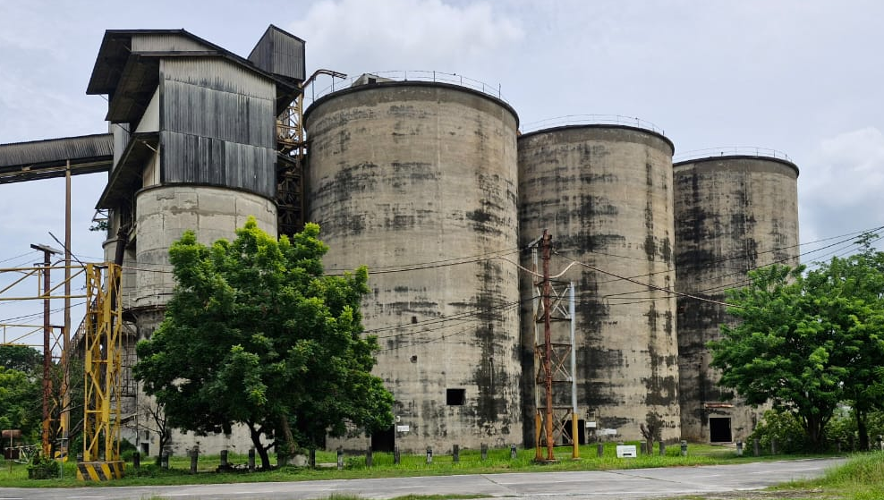
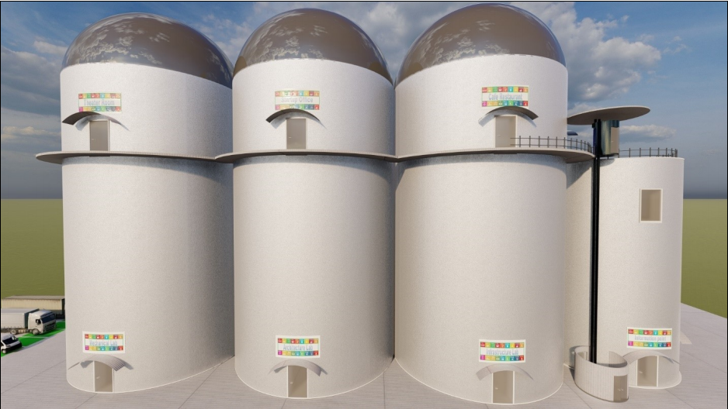
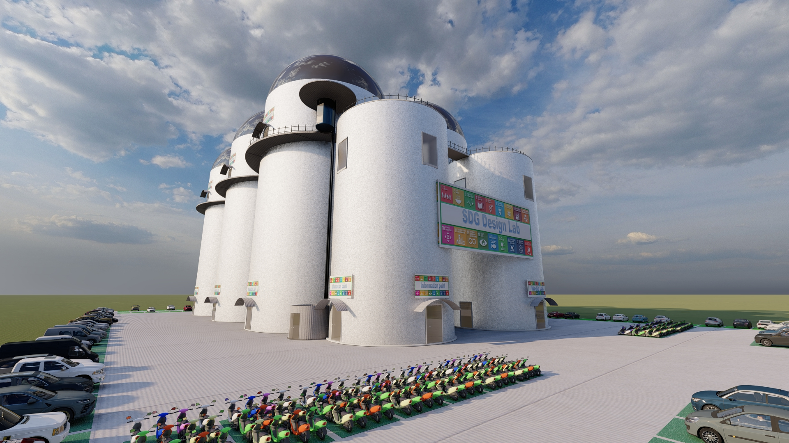
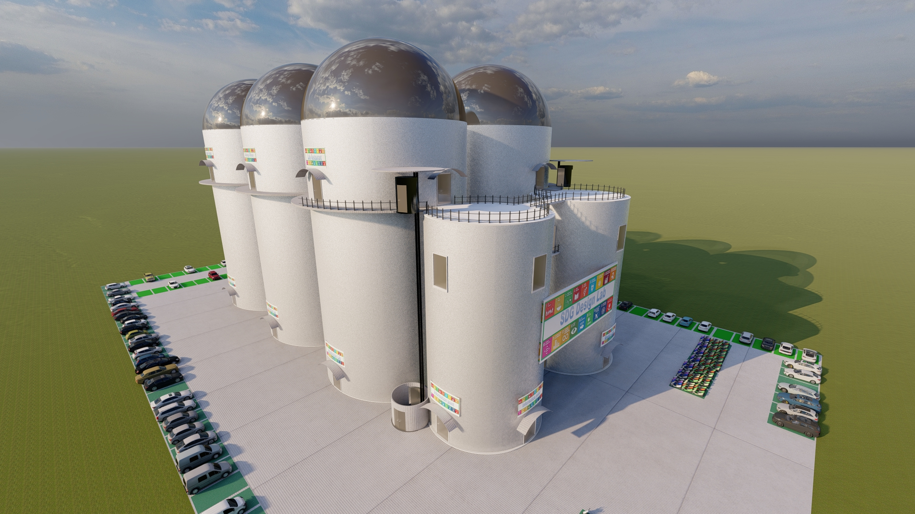
SILO - SDGS DESIGN LAB
2 unit Silo kecil
6 unit Silo besar

Slide 4
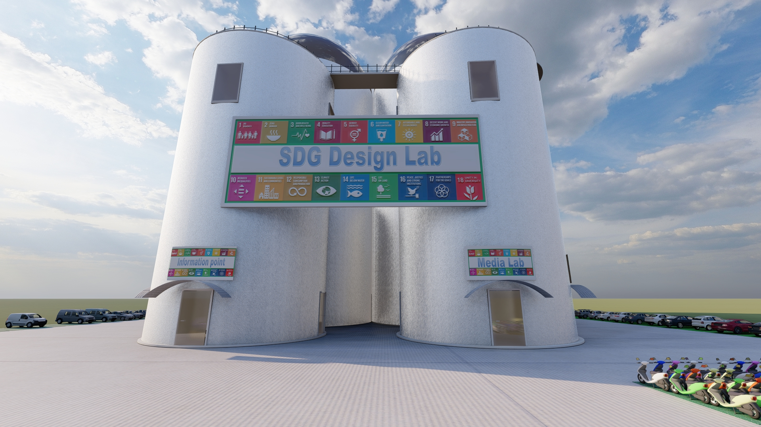
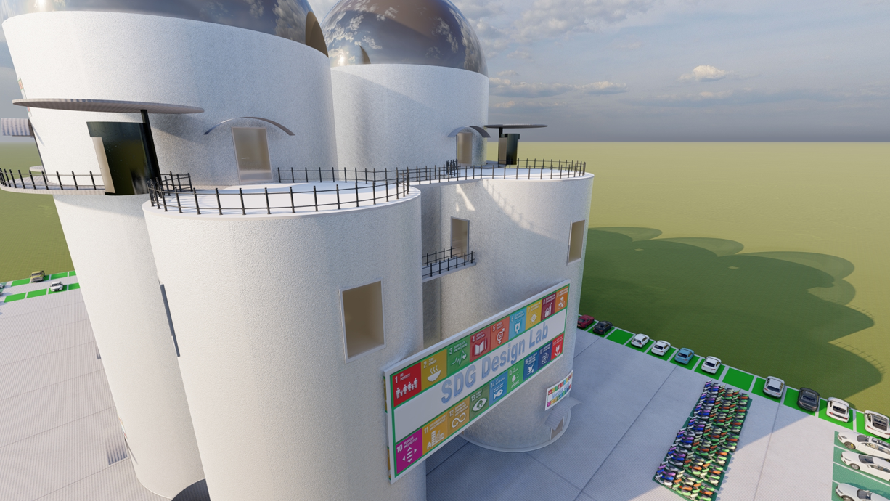
SDGS DESIGN LAB
FASILITAS LABORATORIUM
Renewable Energy Lab
Electro Engineering Lab
Mechanical Engineering Lab
Civil Engineering Lab
Sustainable Architecture Lab
Robotica Lab
Food Lab
Media Lab
Confection Lab
BOTTOM SILO
Renewable Energy Lab
Electro Engineering Lab
Mechanical Engineering Lab
Civil Engineering Lab
Sustainable Architecture Lab
Robotica Lab
Food Lab
Media Lab
Confection Lab
Brainstorm Room
Meeting Room
Presentation Room
FASILITAS RUANGAN
Brainstorm Room
Meeting Room
Presentation Room
Start-up Offices
Board Room
Education Room
TOP SILO
Start-up Offices
Board Room
Education Room
etc

Slide 5
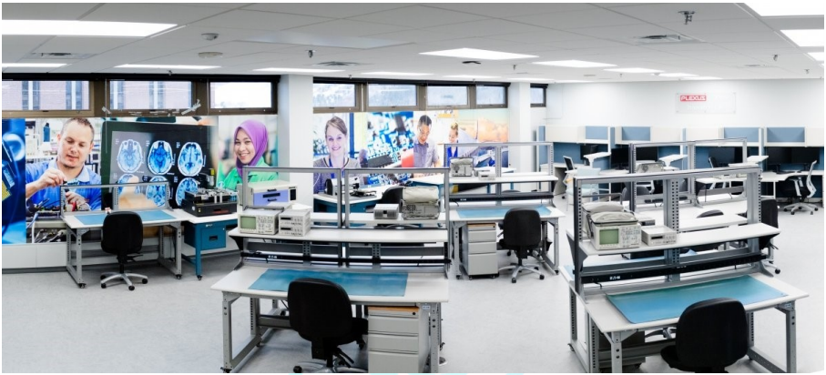
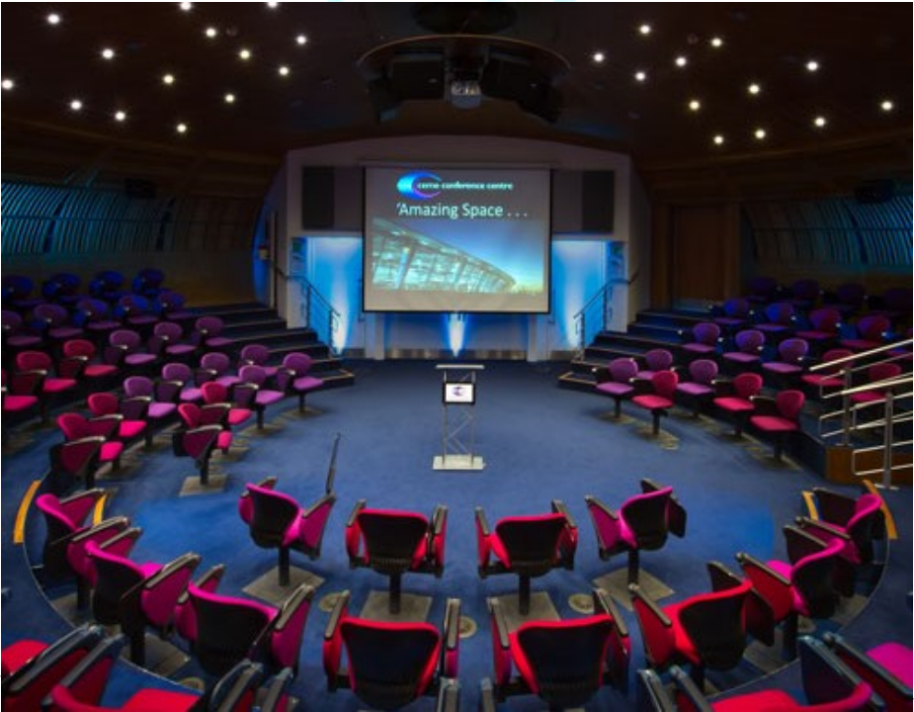
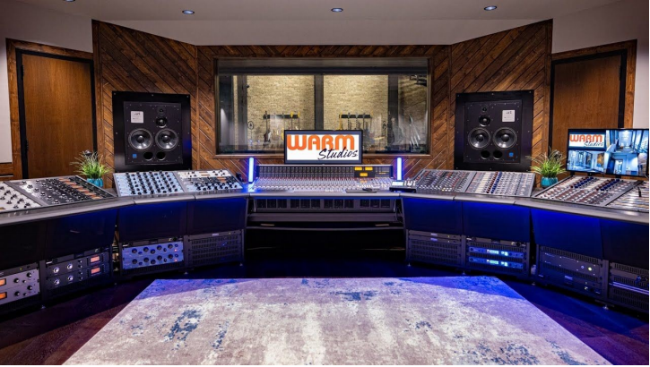
CONTOH : SDGS DESIGN LAB

Slide 6
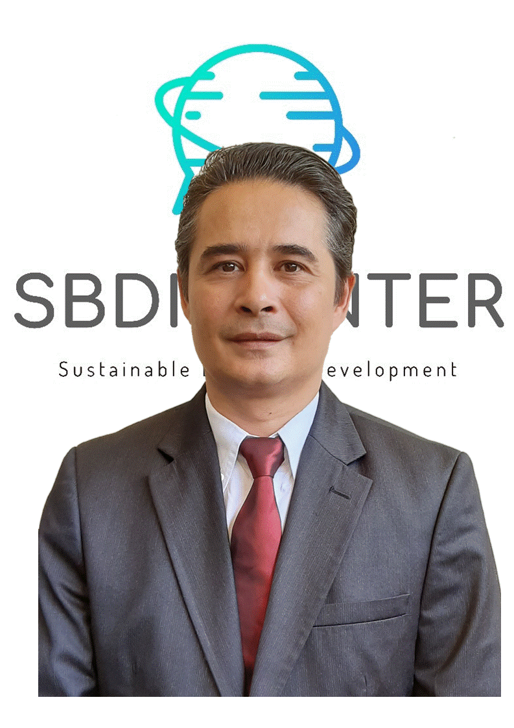

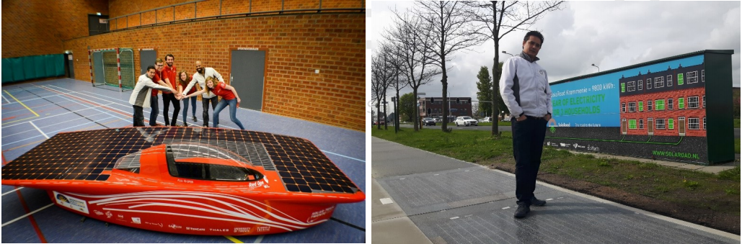
MITRA POLTEKSI - KONSULTAN
Public Speaking, Sustainability, Circularity, Economy, Creative Technology and Practical Business Development
Ambassadors of the University of Twente and the United Nations Global Compact
Involved in multiple innovative projects around the world.
Consulting and Advising (stakeholders, policymakers, and start-ups)
Collecting and Analysing (environmental projects)
Research (renewable energy, climate change, and food & water)
Partnerships Management, and
International Networking
Mr. Jeroen Rijnenberg
Board of Advisor

Slide 7
BENEFIT SDGS DESIGN LAB
INTERNAL
Pemberdayaan melalui pendidikan potensi bakat dan generasi inovatif.
Sistem pendidikan mandiri.
Dijalankan oleh mahasiswa untuk mahasiswa
Keterlibatan erat mahasiswa dan startup dalam praktik berkelanjutan.
Bank data R & D serta pengetahuan berkelanjutan.
Proyek percontohan (prototype).
Penciptaan startup.
EXTERNAL
Kemitraan strategis
Program penggalangan dana.
Peluang untuk pengembangan ekonomi, pengembangan produk dan kegiatan inovasi.
Pengembalian dampak, dan pengembalian investasi bagi investor dan donatur.

Slide 8
TUGAS MAHASISWA & JENJANG KARIR
Keterlibatan mahasiswa selama 3 tahun pada kegiatan Design Lab akan mendapatkan berbagai pelatihan, yang menyangkut bidang : finansial, komunikasi, operasional, proyek, teknikal dan eval & laporan
Ruang lingkup tugas mahasiswa :
Exclusive Officer ► perencanaan kegiatan, monitoring dan laporan kegiatan
Financial Officer ►perencanaan keuangan, monitoring dan laporan keuangan
Communication Officer ►komunikasi dengan sosial media, internal & external, para pihak terkait, kegiatan keluar (event)
Operational Officer ► persiapan event, pengaturan staf, menjaga barang persediaan, dan operasional organisasi
Project Officer ►monitoring proyek, analisa dan laporan proyek serta pengarah start up
Technical Officer ►monitoring fasilitas, peralatan lab, mendukung kegiatan bersifat teknis
Education Officer ►perencanaan pelatihan, monitoring dan laporan kegiatan pelatihan

Slide 9
TUGAS MAHASISWA & JENJANG KARIR
Start Up
Dosen
Manager
Chief
Konsultan
Operator
NO | STAFF | TASK
1 | Operator | Writing report, technical support, preparation, monitoring, maintaining, etc
2 | Manager | Manage, controller, fix problems, monitor operator, reporting, educate operator, etc
3 | Chief | Operational strategy, operational management, project strategy, development, etc
4 | Start Up | Implement of the 17 SDG’s
1 | Dosen | Supporting, coaching
2 | Konsultan | Advise, training, education, industrial link, fundraising etc

Slide 10
STRUKTUR ORG (OPERASIONAL)
Board of PoltekSI
Board of Advisor
Executive Board
Chief
CEO (Chief Exclusive Officer)
CFO (Chief Financial Officer)
CCO (Chief Communication Officer)
COO (Chief Operational Officer)
CPO (Chief Project Officer)
CTO (Chief Technical Officer)
CEDO (Chief Education Officer)
name ?
Manager
Exclusive
Financial
Communication
Operational
Project
Technical
Technical
name ?
Operator
Exclusive
Financial
Communication
Operational
Project
Technical
Technical
name ?

Slide 11
ROADMAP SDGS DESIGN LAB POLTEKSI
MOU/ NDA
Board formulation
Legalisation
Education program
Opening month (pilot)
Operations
1
2
3
4
5
6
Business plan
Feasibility study
Croudfunding fundraising (1)
Construction
Croudfunding fundraising (2)
Operational Goal
ok
kegiatan yang melibatkan mahasiswa
in progress
not yet

Slide 12
SUSTAINABLE DEVELOPMENT GOALS
No Poverty (Tanpa Kemiskinan)
Zero Hunger (Tanpa Kelaparan)
Good Health and Well-being (Kehidupan Sehat dan Sejahtera)
Quality Education (Pendidikan Berkualitas)
Gender Equality (Kesetaraan Gender)
Clean Water and Sanitation (Air Bersih dan Sanitasi Layak)
Affordable and Clean Energy (Energi Bersih dan Terjangkau)
Decent Work and Economic Growth (Pekerjaan Layak dan Pertumbuhan Ekonomi)
Industry, Innovation, and Infrastructure (Industri, Inovasi, dan Infrastruktur)
Reduced Inequalities (Berkurangnya Ketimpangan)
Sustainable Cities and Communities (Kota dan Permukiman Berkelanjutan)
Responsible Consumption and Production (Konsumsi dan Produksi yang Bertanggung Jawab)
Climate Action (Penanganan Perubahan Iklim)
Life Below Water (Ekosistem Lautan)
Life on Land (Ekosistem Daratan)
Peace, Justice, and Strong Institutions (Perdamaian, Keadilan, dan Kelembagaan Tangguh)
Partnerships for the Goals (Kemitraan untuk Mencapai Tujuan)

Slide 13
TERIMA KASIH

Slide 14
CHIEF EXCLUSIVE OFFICER (CEO)
The Chief Executive Officer of SDG DesignLab is responsible for decision-making and will be guided and
advised by the board of advisors.
Key Responsibilities: Manager of the board, decision maker
Responsibilities include:
Advise strategies and policies to meet the SDG DesignLab goals.
Managing and supervising the day-to-day tasks of the board.
Analysing board functions, audit reports, and formulating improvements to the departmental workings of the board.
Develop board strategies.
Compiling performance reports and reporting to the board of advisors.
Analyse problematic situations and occurrences and provide solutions to ensure company survival and growth.
Communication with stakeholders and investors.
Train the assistant CEO manager
Evaluation report.
Report to the board of advisors
Able and willing to present a cohesive vision and strategy to the board of advisors.

Slide 15
CHIEF FINANCIAL OFFICER (CFO)
The Chief Financial Officer of SBDI is responsible for the financial process and strategy of the SBDI Centre.
Key Responsibilities: Guard the financials, make financial reports.
Responsibilities include:
Advise strategies and policies to meet theSDG DesignLab goals.
Managing and supervising the day-to-day financials of the SDG DesignLab.
Analysing financial and audit reports and formulating improvements to departmental workings of the board.
Develop financial transparency strategy.
Financial stakeholders report.
Financial donation reports.
Financial fundraising report.
Start-ups report.
Financial communication stakeholders and investors.
Automation strategy.
Evaluation report.
Train the assistant CFO manager.
Report to the CEO.
He is able and willing to present a cohesive vision and strategy to the board of advisors

Slide 16
CHIEF COMMUNICATION OFFICER (CCO)
The Chief Communication Officer of the SDG DesignLab executive team reports to the board of directors
and leads our superb in-house marketing team. The duties will include managing all marketing operations,
assessing and improving existing initiatives, devising new strategies to increase revenue, and
complementing the organisation’s objectives.
In charge of excellent leadership and campaign planning skills to successfully guide the team, and has a
vast knowledge of current marketing trends.
Key Responsibilities: Developing and Managing Advertising Campaigns, organising (company
conferences, trade shows, and events), Overseeing Marketing (social media marketing strategy and
content marketing), Building Brand Awareness and Positioning.

Slide 17
CHIEF COMMUNICATION OFFICER (CCO)
Responsibilities include:
Planning, implementing, and overseeing all marketing and advertising campaigns.
Developing a communication strategy.
Growing and developing the in-house marketing team.
Building a network of reliable external agencies and marketing professionals.
Conducting market research and staying abreast of competitor positioning.
Contributing to new business development initiatives.
Marketing budget management.
Internal and external communication.
Communication to stakeholders and investors.
Evaluation report.
Report to the CEO.
Train the assistant CCO manager

Slide 18
CHIEF OPERATIONAL OFFICER (COO)
The Chief Operational Officer from SDG DesignLab is responsible for all operational tasks. He will guide
the operational management and will develop operational strategies.
Key Responsibilities: Operational strategy, operational management.
Responsibilities include:
Communicate with operational stakeholders.
Develop operational strategy.
Budgeting operational cost.
Train operational manager.
Evaluation report
Report to CEO.
Manage conflicts

Slide 19
CHIEF PROJECT OFFICER (CPO)
The Chief Project Officer from SDG DesignLab is responsible all the projects within the SDG DesignLab.
Key Responsibilities: Operational strategy, operational management.
Responsibilities include:
Project development.
Start-ups monitoring.
Project strategy.
Train project manager.
Evaluation start-ups report.
Investment relations.
Start-ups screening.
Report to CEO.

Slide 20
CHIEF TECHNICAL OFFICER (CTO)
The Chief Technical Officer from SDG DesignLab is responsible for all the technical aspects within the SDG DesignLab.
Key Responsibilities: Technical maintenance, technical training, technical knowledge transfer, the main goal is to manage the prototype lab, up to date, and observe the latest trends of new technologies
Responsibilities include:
Product development.
Start-ups monitoring.
Project strategy.
Train technical manager.
Evaluation start-up report.
Process communication.
Technical start-ups screening.
Manage protolab
Report to CEO.

